Slide 1
Simple ER Examples

Slide 2
Drawing tools
Lucidchart
www.lucidchart.com/pages/home
Draw.io
www.draw.io

Slide 3
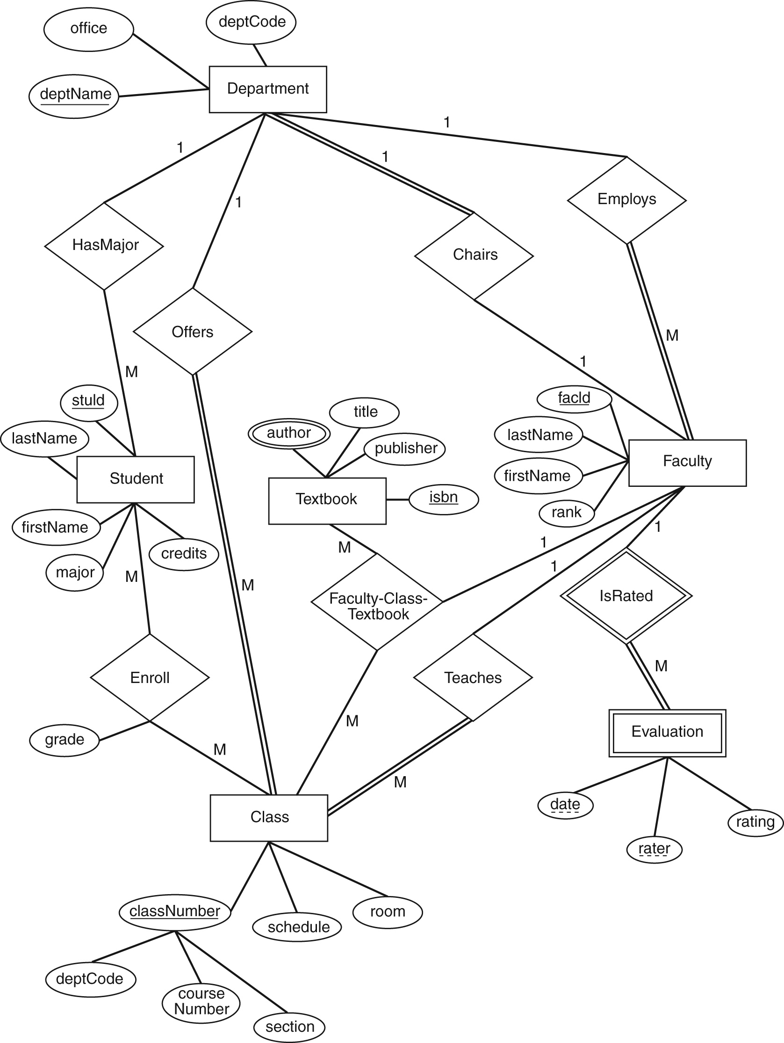
Chen notation

Slide 4
Example 1
X’s meet Y’s
An X may meet one or more Y’s.
A Y may meet one or more X’s.
An X is uniquely identified by its name.
A Y is uniquely identified by its ID.
The time that an X and Y meet is important.

Slide 5
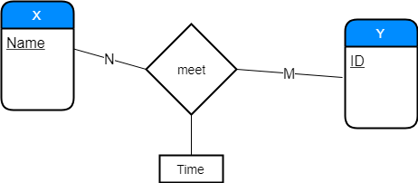
X’s meet Y’s

Slide 6
Example 2
Y’s eat X’s
A Y must eat at least one X.
An X is eaten by exactly one Y.

Slide 7
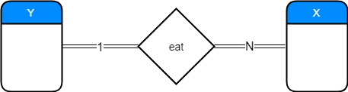
Y’s eat X’s

Slide 8
Example 2+
Y’s eat X’s
A Y must eat at least one X.
An X is eaten by exactly one Y.
An X is uniquely identified by its name.
For Y’s we must store their home address (#, street, city, state, country, postcode) and the number of X’s they have eaten.
A Y has a unique email address and may have more than one phone numbers.

Slide 9
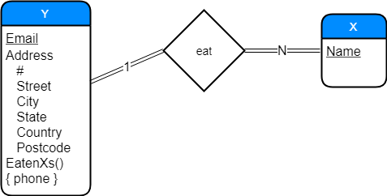
Y’s eat X’s

